Slide 1


UK Crime Data Analysis
Presenter
Date
Muhammed Salim ,Data Analyst
Last updated on 08/07/2024.

Slide 2

UK Crime Data Analysis
This presentation examines crime trends in England And Wales. We'll explore key findings, anomalies, and recommendations based on comprehensive data analysis. Our insights aim to inform law enforcement strategies and policy decisions.

Slide 3

Approach and Methodology
1
Data Source
Comprehensive crime data categorized by year, location, and type from official police records.
2
Data Cleaning
Rigorous process of combining datasets, handling missing values, and removing duplicates for accurate analysis.
3
Analysis Techniques
Employed trend analysis, correlation studies, Z-score anomaly detection, and geographical mapping for insights.

Slide 4

Total Recorded Crime
1
Massive Dataset
Analysis encompassed approximately 26 million recorded crime incidents across the UK.
2
Wide Coverage
Data collected from 56 different areas, providing a comprehensive view of crime patterns.
3
Longitudinal Study
Multi-year data allows for trend analysis and identification of long-term patterns.

Slide 5




Anomalies in Crime Data
Burglary Anomalies
Highest number of statistical outliers identified using Z-score analysis.
Data Patterns
Unusual spikes and dips in crime rates detected across various categories.
Further Investigation
Anomalies highlight areas requiring deeper analysis and targeted interventions.

Slide 6
Top Increasing and Decreasing Crimes
Burglary
Shoplifting
Public Order Offences
Significant year-over-year changes observed, with notable fluctuations in urban areas.
Percentage changes indicate shifting patterns, possibly influenced by economic factors.
Marked trends identified, potentially correlating with social and political events.

Slide 7
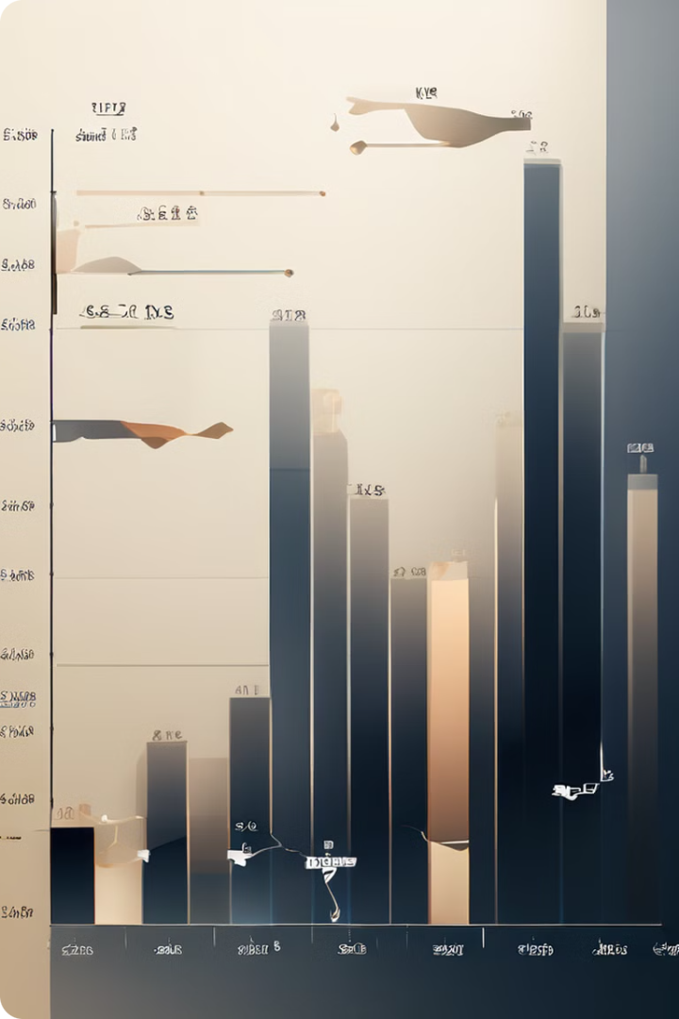
Knife Crime Trends
Year
Percentage
2019
20.9%
2020
22.62%
2021
19.38%
2022
18.1%
2023
19%

Slide 8

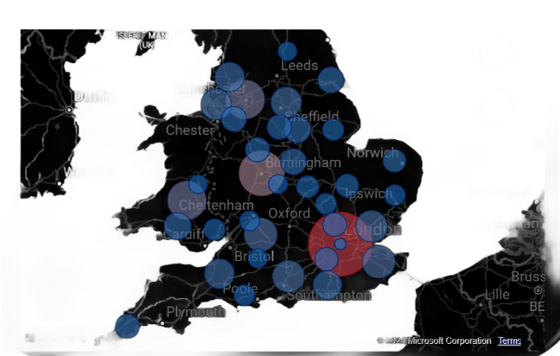


Most Dangerous City: London
High Crime Rates
London consistently shows elevated crime statistics across multiple categories.
Significant Trends
Notable patterns in violent crimes and property offenses identified.
Resource Allocation
Findings suggest need for targeted policing and community intervention strategies.

Slide 9



Top Areas Affected by Fraud and Computer Misuse
London
Greater Manchester
West Midlands
Highest incidence of fraud and computer misuse, likely due to its financial center status.
Second-highest rates, potentially linked to its growing tech industry and urban density.
Third most affected area, showing a concerning trend in digital-age crimes.

Slide 10

Conclusions and Recommendations
1
Targeted Interventions
Focus resources on high-crime areas and increasing offense types, particularly in London.
2
Policy Adjustments
Implement data-driven policies addressing root causes of crime rate fluctuations.
3
Further Research
Conduct in-depth studies on crime correlations and evaluate current law enforcement practices.

Slide 11

Thank You For Listening
I hope this analysis has provided valuable insights. Please let me know if you have any questions.

